Slide 1
BANK LOAN ANALYSIS
Presented By Group No:-6

Slide 2
INDEX
# Introduction.
# Observation and suggestion of KPI’S.
# Dashboard.
# Learn key’s from Group Project.
# Conclusion.
# Difficulties face during project.

Slide 3
TEAM INTRODUCTION.
Sr no. | Name | Email id
1 | Sanjana Jujare | sanjanajujare160@gmail.com
2 | Tanuja Tukaram Kharshinge | tanuja.kharshinge9@gmail.com
3 | Sameer Sharieff | sameersharieff46@gmail.com
4 | MR.ASHISH | asdhull872@gmail.com
5 | Manjeera Ravipati | manjeera120899@gmail.com
6 | Pratiksha Dnyaneshwar Kuyate | kuyatepratiksha@gmail.com
7 | Shital Ramesh Ghangoankar. | shitalghangoankar@gmail.com
Mentors Name.
Priti mam.

Slide 4
KPI’S
KPI’S | Amount
Total account | 66K
Total Funded Loan | 733M
Total payment | 815M
Total Interest | 155M
Total Collection | 808M

Slide 5
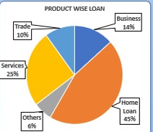
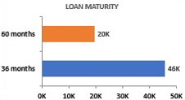
# Product Wise Loan :-
Granting loan is a kind of credit activity in which the commercial banks or other credit institutions lends money, at a certain interest rate and an agreed repayment period, to other institutions in need of funds.
# Loan Maturity :-
The date on which a borrower's final loan payment is due. Once that payment is made and all repayment terms have been met, the promissory note that is a record of the original debt is retired.

Slide 6
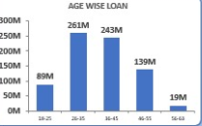
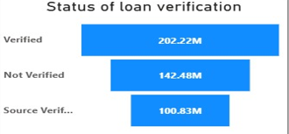
# Age Wise Loan :-
Most lenders require borrowers to be between 21 and 60 years old for personal loans, with the maximum age often being 60-65 at the time of loan maturity. This age range ensures a reasonable repayment timeline and stability for the lender. However, specific lenders may have slightly different age requirements.
# Status Wise Loan :-
Typically use your lender's online banking or mobile app, visit their website, or contact their customer service. Loan statements sent by your lender also provide detailed information about your loan. You can also visit the lender's branch in person or call their customer service line for assistance.

Slide 7
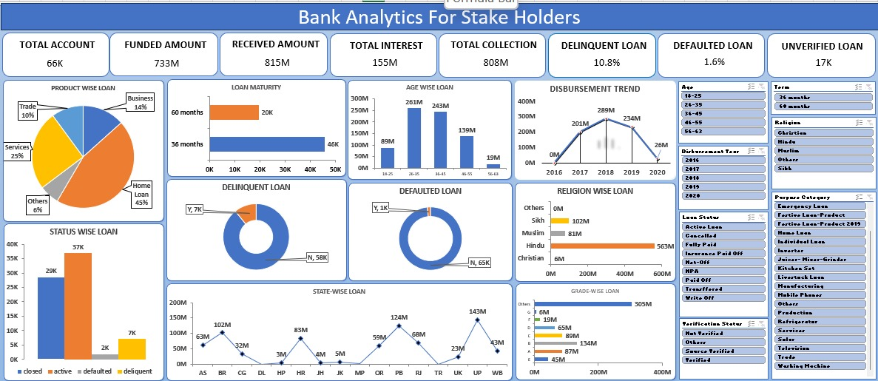
EXCEL DASHBOARD.

Slide 8
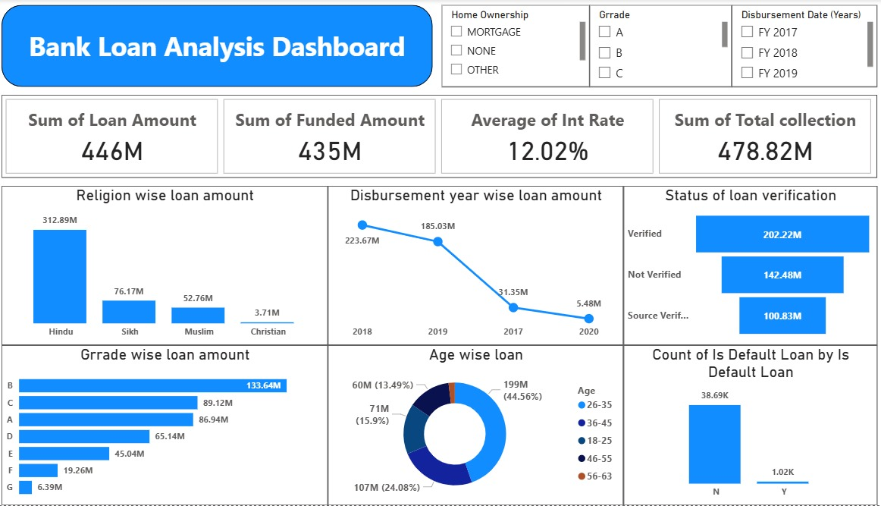
POWER BI DASHBOARD.

Slide 9
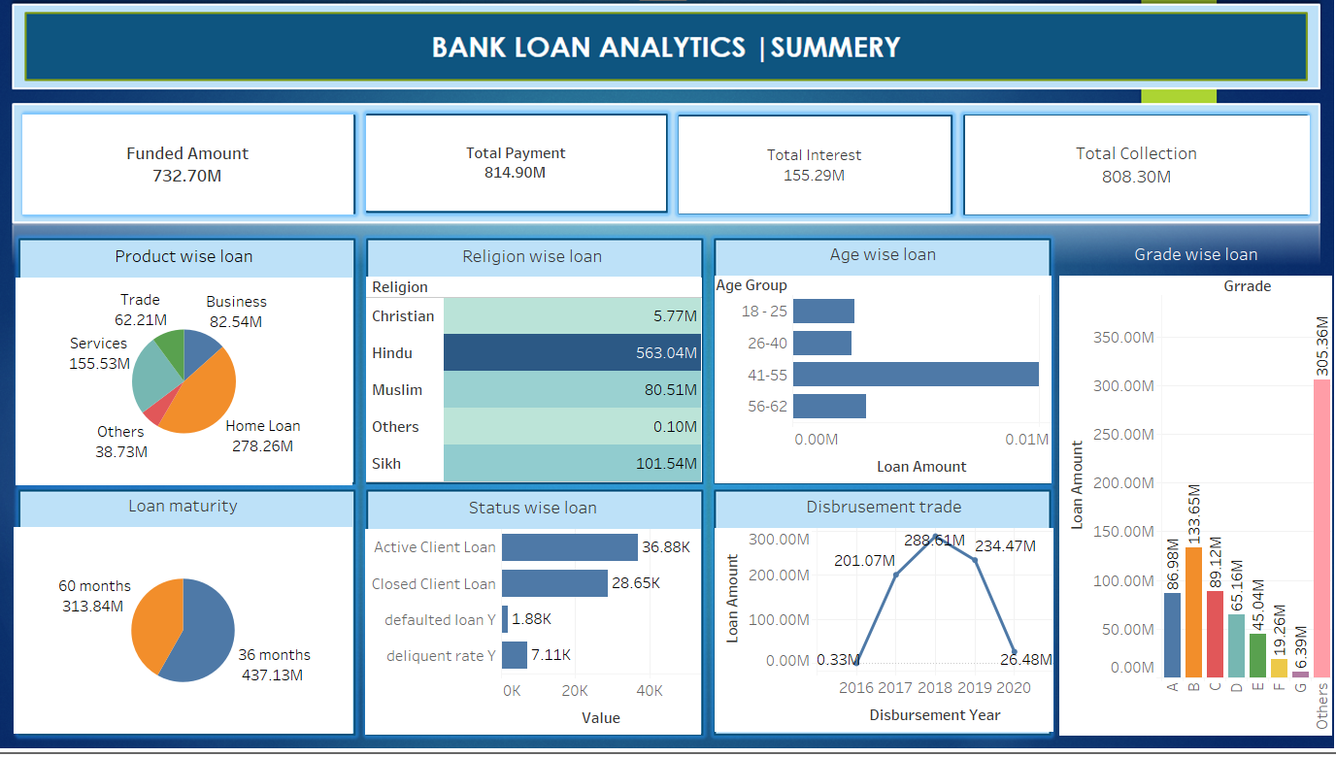
TABLEAU DASHBOARD.

Slide 10
-: CONCLUSION :-
summarize the project's potential, highlighting its strengths, financial viability, and the borrower's ability to repay the loan. It reinforces the borrower's credibility and demonstrates the project's long-term success prospects.
outline the purpose of the loan, the amount needed, and how it will be utilized. It should also include a detailed business plan, highlighting the potential for growth and profitability. Additionally, the report should address any potential risks and how they will be mitigated.

Slide 11
-: Learn key from group project :-
Break complex tasks into steps.
Plan and manage time.
Challenge assumptions.
Refine understanding through discussion and explanation.

Slide 12
-: Difficulties faced during group project :-
Making Relation in the table.
To understand complex dataset.
Understanding key performance indicator’s.
Painful meetings.

